Slide 1
CSC258 – Project
Snake
By Darwin and Hongyu

Slide 2
Block Diagram

Slide 3
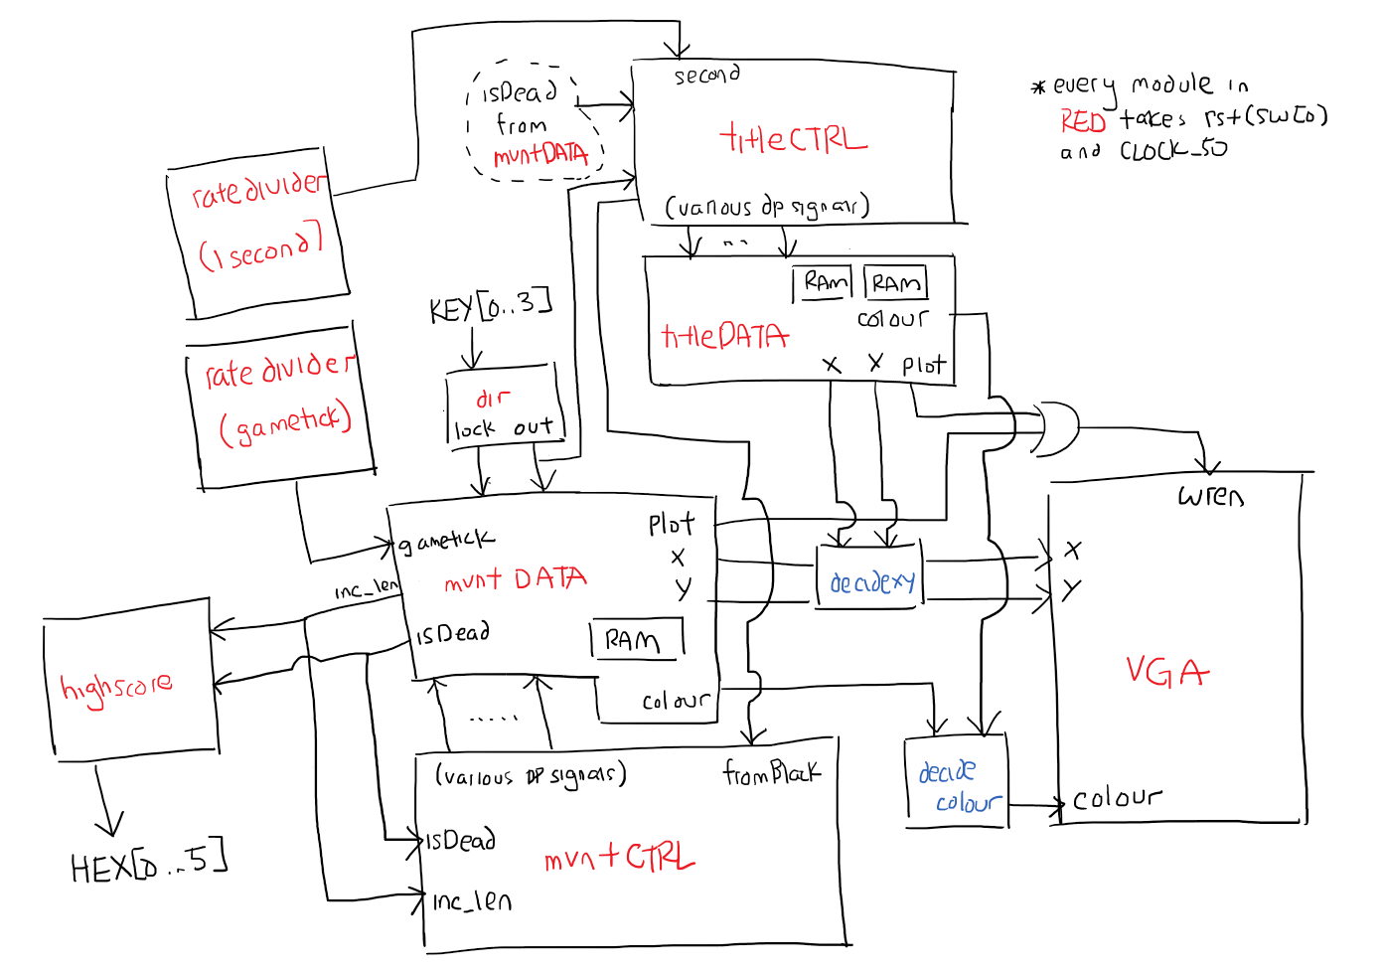

Slide 4
Snake Drawing FSM
First load initial positions of the Snake into the RAM in the form {x, y}
Draw from the RAM the current positions iterating through the first (length) positions
Update the position of the HEAD based on the direction the user has currently selected
Draw the new HEAD
Erase the previous position of the TAIL by drawing over it with black

Slide 5
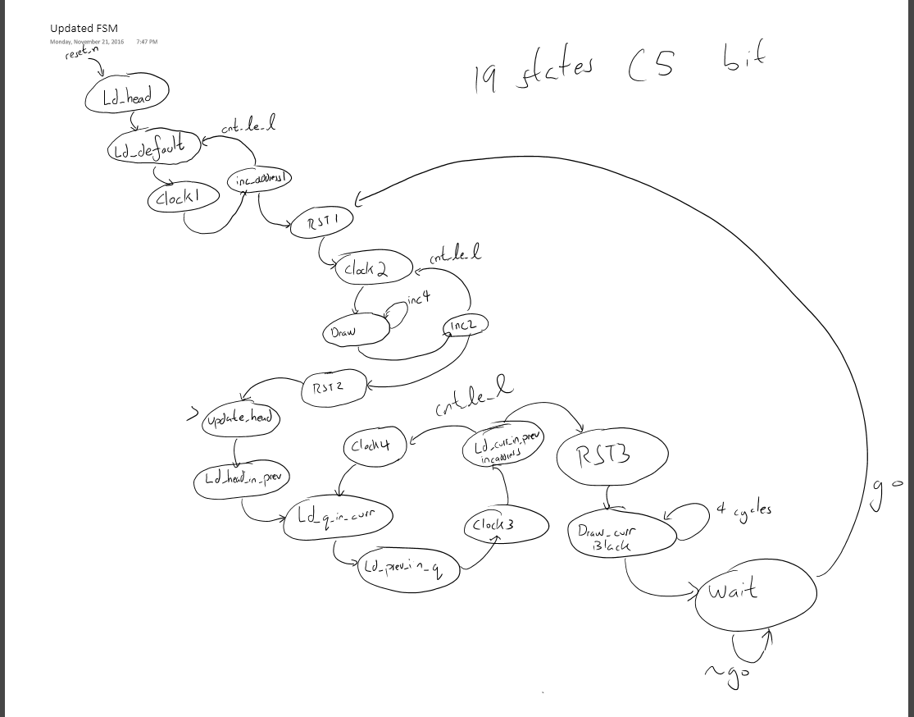

Slide 6
Game State FSM
Determines what is drawn on the screen
Transitions on user input / losing
Title and Game Over screen are bmp images
Animation is done by determining which ram
to read from inside the Datapath module
Title
Game
Game Over

Slide 7
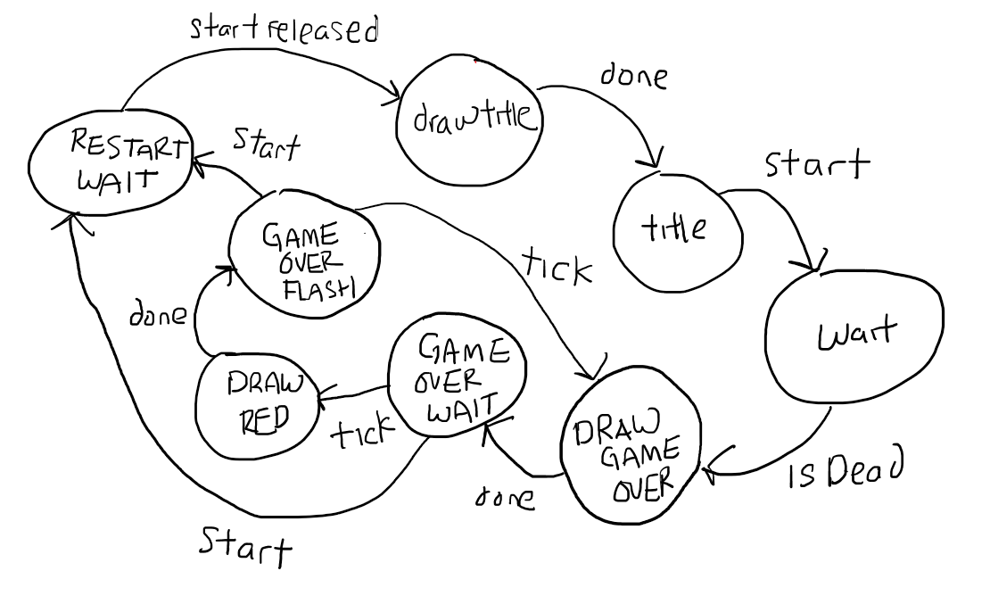

Slide 8
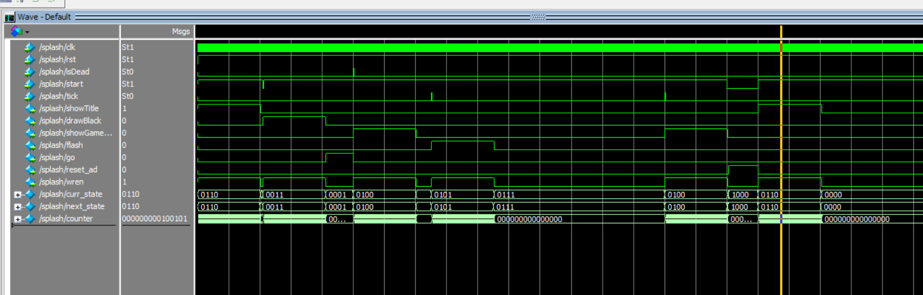
Title screen is drawn (start)→ Main game loop (isDead) → Show Game Over (start) → Title Screen

Slide 9
Problems We Ran Into
Understanding how to properly load and draw our stored values from the RAM, the address was being displayed one clock cycle too late
In order to fix this we implemented wait states to load the addresses before trying to read from the address in the RAM
Trying to load .bmp files and drawing them on the screen, the pictures were being draw much differently then we expected
This was an issue because the way we implemented the coordinates of the Snake initially was by concatenating the values of x and y and storing it in some address of the RAM, however the values were actually stored as the absolute pixel number

Slide 10
What We Learned
How to build a large, complex project with many parts
Carefully designing and testing individual modules as well as putting them together
Properly planning out and organizing the workload as well as collaborating through version control software
Integrating everything that we learned from previous labs
First hand experience on working with memory
Properly loading and reading from RAM in order to draw and update the Snake position
Drawing from preloaded RAM for images and animations

Slide 11
Summary Table
Hongyu | Darwin
Snake FSM Snake Datapath Food drawing mechanics High score system | Game State FSM Game State Datapath Snake Datapath Direction control

